Slide 1


Common Core State Standards
Shifts in Mathematics
NM Educator Leadership Cadre
Cathy Kinzer and Lynn Vasquez

Slide 2
Research Connection
Dr. Bill Schmidt from Michigan State University surveyed teachers on implementation of CCSSM:
After reading sample CCSSM topics for their grade, ~80% say CCSSM is “pretty much the same” as their former standards
If CCSSM places a topic they currently teach in a different grade only about ¼ would drop it

Slide 3
The Definition of Insanity?
Doing the same thing and expecting different results…

Slide 4
The Background of the Common Core State Standards
Initiated by the National Governors Association (NGA) and Council of Chief State School Officers (CCSSO) with the following design principles:
  Result in College and Career Readiness
  Based on solid research and practice evidence
  Fewer, clearer and more rigorous
Notes:
To have more students meeting the requirements for post-secondary success, there needed greater clarity in what is expected of students each year during k-12 education.
Typical state standards that preceded the Common Core were too vague and too long to realistically inform instruction.
So the Common Core was designed to be a set of standards that are fewer in number, clearer in describing outcomes, and higher. What is included is what is expected for ALL students.
To help students achieve these standards, all practitioners must be honest about the time they require. Teaching less at a much deeper level really is the key to Common Core success.
The decisions surrounding how to focus the standards had to be grounded in evidence regarding what students in fact need in order to have a solid base of education and to be well prepared for career or college demands.
There had to be many decisions about what not to include. The focus was narrowed to what mattered most. You can look at the anchor standards and probably agree that all of them are skills you would really want every student you know and care about to leave school able to exercise.
So the CCSS represent that rarest of moments in education when an effort starts by communicating that we must stop doing certain things, rather than telling educators about one more thing they can add to their already overbooked agenda to help support their students. You can think of the standards and this focus on the shifts that really are at the center of what is different about them as the “power of the eraser” over the power of the pen.

Slide 5
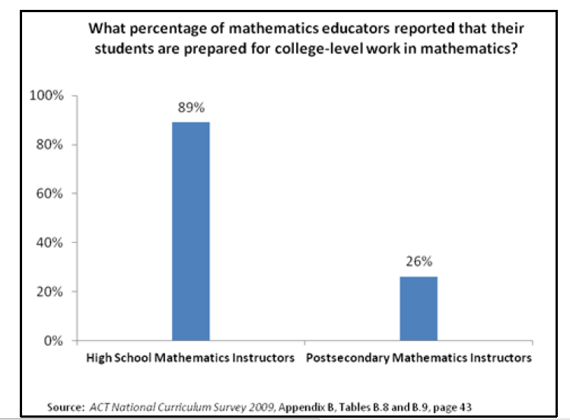
College Math Professors Feel HS students Today are Not Prepared for College Math
Notes:
We see that there is a disconnect between how prepared high school math educators believe their students are for college mathematics and how prepared post secondary math instructors feel the students are.
Notice that this slide shows that HS math teachers feel that 89% of their students are ready for college level math, while college math teachers feel only 26% of their students are prepared.
Rather than spend too much time and energy placing blame or thinking about why this disconnect exists, let’s instead turn to the implications of such a disconnect.

Slide 6
What The Disconnect Means for Students
Nationwide, many students in two-year and four-year colleges need remediation in math
Remedial classes lower the odds of finishing the degree or program
Need to set the agenda in high school math to prepare more students for postsecondary education and training
Notes:
As mentioned before, many students in two and four year colleges need remediation in math which often lowers their odds of finishing the degree or program they are in. Shouldn’t students who graduate from high school be prepared for postsecondary education and training?

Slide 7
Learning Goals for the Session
What are the six shifts in mathematics required of CCSS?
What are the implications for instruction, curriculum and assessment?
Notes:
Today’s session is an overview of the key shifts that the Common Core State Standards require for mathematics. We will be learning about the 6 shifts through this slide show as well as through the discussion. Through this we hope to gain a better understanding of the Standards for Mathematics which in turn will better prepare our students.

Slide 8
What are the 6 Shifts in Mathematics?
Focus
Coherence
Fluency
Deep Understanding
Applications
Dual Intensity
Notes:
We will go through them 1 by one to provide an over view. The six shifts define how instruction and learning opportunities must change…
Then discuss

Slide 9
The Six Shifts in Mathematics:
Represent key areas of emphasis as teachers and administrators implement the Common Core State Standards for Mathematics. Establishing a statewide focus in these areas can help schools and districts develop a common understanding of what is needed in mathematics instruction as they move forward with implementation
Must be enacted in order to make changes to instruction and the opportunities students have to learn mathematics
Shape the PARCC assessments
Notes:
Today’s session is an overview of the six shifts that the Common Core State Standards require for mathematics.

Slide 10
Shift #1 Focus
Focus strongly where the Standards Focus
Teachers use the power of the eraser and significantly narrow and deepen the scope of how time and energy is spent in the math classroom. They do so in order to focus deeply on only the concepts that are emphasized in the standards so that students can engage in the mathematical practices, engage in rich discussions, reach strong foundational knowledge and deep conceptual understanding.
Focus ensures students learn important math content completely rather than superficially.
Notes:
Focus focus in the standards quite directly means that the scope of content is to be narrowed. This is that notion of “The power of the eraser”. After a decade of NCLB, we have come to see “narrowing” as a bad word – and when it means cutting arts programs and language programs, it is. But meanwhile, math has swelled in this country. It has become a mile wide and an inch deep. The CCSSM is telling us that math actually needs to lose a few pounds.
Just as important is that we are deepening expectations as well. So rather than skating through a lot of topics – covering the curriculum, we are going to have fewer topics on our list, but the expectations in those topics are much deeper. Without focus, deep understanding of core math concepts for all students is just a fantasy.
A study of the standards demonstrates that there are areas of emphasis already engineered into the standards at each grade level

Slide 11
Move away from "mile wide, inch deep" curricula identified in TIMSS
Learn from international comparisons
Teach less, learn more
“Less topic coverage can be associated with higher scores on those topics covered because students have more time to master the content that is taught.”
– Ginsburg et al., 2005
Notes:
The Third International Math and Science Study (TIMSS) not only ranks assessment performance of many industrialized nations, but also analyzes the education systems of those countries. The TIMSS study showed that the U.S. covers far more topics than those countries that significantly outperform us. In fact, the TIMSS study revealed that in grade 4, high scoring Hong Kong omitted 48 percent of the TIMSS items. The U.S., on average, omitted only 17%. In the U.S. we have been covering more topics with the net result of learning less about them.
Interestingly, the slogan on the Singapore Ministry of Education’s website is “Teach less, learn more.” By focusing curriculum and instruction, teachers have the opportunity to support students in the development of strong foundations that pay off as the progress through more complex math concepts.
{read quote from bottom of slide}

Slide 12
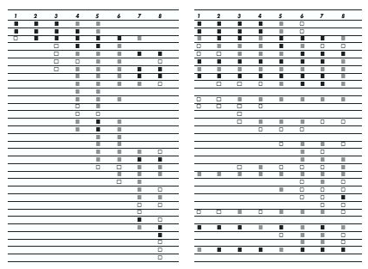
The Shape of Math in A+ Countries
Mathematics topics intended at each grade by at least two-thirds of A+ countries
Mathematics topics intended at each grade by at least two-thirds of 21 U.S. states
¹ Schmidt, Houang, & Cogan, “A Coherent Curriculum: The Case of Mathematics.” (2002).
Notes:
There are no detailed labels here because I want you to see visually that the overall shape of math topics in A+ countries and those typical in the US (pre-Common Core) is different.
Each row is a math topic, like fractions, or congruence.
In 2/3rds of the high-performing countries, the foundations are laid and then further knowledge is built on them. The design principle is focus and coherent progressions.
In the U.S., the design principle is to teach everything every year that can possibly be taught… as well as many things that cannot.

Slide 13
Traditional U.S. Approach
 | K 12
Number and Operations
Measurement and Geometry
Algebra and Functions
Statistics and Probability
Notes:
This slide represents another visualization of how U.S standards used to be arranged, giving equal importance to all four areas - like “shopping aisles.” Each grade goes up and down the aisles, tossing topics into the cart, losing focus.
There is no disagreement, for example, that the most critical area of mathematics in K-2 is numbers and operations. However, whether looking at typical state standards or typical curriculum that followed, numbers and operations was just one concept among many that was included.
The Common Core State Standards is a set of standards that allow teachers to do what they know they need to in order to support the further development of their students: concentrate on fewer, powerful concepts and then build on those.

Slide 14
CCSS Number and Operations Progression
 | Operations and Algebraic Thinking |  |  |  |  |  |  | Expressions and Equations |  |  |  | Algebra
 |  |  |  |  |  |  | → |  |  |  | →
 | Number and Operations—Base Ten |  |  |  |  |  | → | The Number System
 |  |  |  |  |  |  |  |  |  |  | →
 |  |  |  | Number and Operations—Fractions |  |  | →
 | K | 1 | 2 | 3 | 4 | 5 |  | 6 | 7 | 8 |  | High School
Notes:
The CCSS takes the first strand from the last slide (Number and Operations) and expands it to show the relevance and progression of number and operations from K-12. You can see that the one "shopping aisle" or strand of Number and Operations from previous states standards is now split into 5 domains across the K-8 grade span, communicating exactly what is being learned at each grade and clarifying how that learning prepares the students for future studies.

Slide 15
Key Areas of Focus in Mathematics
Grade | Focus Areas in Support of Rich Instruction and Expectations of Fluency and Conceptual Understanding
K–2 | Addition and subtraction - concepts, skills, and problem solving and place value
3–5 | Multiplication and division of whole numbers and fractions – concepts, skills, and problem solving
6 | Ratios and proportional reasoning; early expressions and equations
7 | Ratios and proportional reasoning; arithmetic of rational numbers
8 | Linear algebra
Notes:
Focus in the Common Core Standards means two things. What is in versus what is out, but also what the main focus of the standards are for each grade. This chart shows what the major focus areas are for K-8 math. These are the concepts which demand the most time, attention and energy throughout the school year. It is through focus in these key areas in K-8, that students will be best be prepared for further studies of math in HS and consequently, college and career ready.
It is important to note that these are not topics to be checked off a list during an isolated unit of instruction, but rather these priority areas will be present throughout the school year through rich instructional experiences.

Slide 16
Shift #2 Coherence
Think Across Grades, and Link to Major Topics Within Grades
Carefully connect the learning within and across grades so that students can build new understanding on foundations built in previous years.
Begin to count on solid conceptual understanding of core content and build on it. Each standard is not a new event, but an extension of previous learning.
Notes:
{Read slide}
In the second shift of coherence, we take advantage of focus to actually pay attention to sense-making in math. Coherence speaks to the idea that math does not consist of a list of isolated topics.
The Standards themselves, and therefore any resulting curriculum and instruction, should build on major concepts within a given school year as well as major concepts from previous school years.
Typically, current math curriculum spends as much as 25% of the instructional school year on review and re-teaching of previous grade level expectations – not as an extension – but rather as a re-teaching because many students have very little command of critical concepts.
Just as there are two ways to look at focus, there are two elements of coherence: The coherence across grades and the coherence that links topics to the major work of the grade.
Creating mathematical connections
Forming a weave of progression of increasing knowledge, skill, or sophistication
Forming a connection between the content standards and the practice standards
Ensure that students see mathematics as a logically progressing discipline that has specific connections among its various domains and requires a sustained practice to master. Some of the connections in the CCSS knit topics together at a single grade level. Most connections, however, play out across two or more grade levels to form a progression of increasing knowledge, skills or sophistication. The standards are woven out of these progressions. Likewise, instruction at any given grade would benefit from being informed by a sense of the overall progression students are following across the grades. Another set of connections is found between the content standards and the practice standards. These connections are absolutely essential to support the development of students’ broader mathematical understanding. Coherence is critical to ensure that students see mathematics as a logically progressing discipline, which has intricate connections among its various domains and requires sustained opportunities to learn deeply.

Slide 17
Coherence: Think Across Grades
Example: Fractions
“The coherence and sequential nature of mathematics dictate the foundational skills that are necessary for the learning of algebra. The most important foundational skill not presently developed appears to be proficiency with fractions (including decimals, percents, and negative fractions). The teaching of fractions must be acknowledged as critically important and improved before an increase in student achievement in algebra can be expected.”
Final Report of the National Mathematics Advisory Panel (2008, p. 18)
Notes:
{read slide regarding fraction example}
As an example of coherence, the Common Core State Standards takes a different approach to preparing students for success in algebra. Previous approaches moved topics of pre-algebra and algebra earlier and earlier in the grade sequence rather than attend to careful progressions of conceptual development that in fact prepare students for algebra.

Slide 18
CCSS
4.NF.4. Apply and extend previous understandings of multiplication to multiply a fraction by a whole number.
Grade 4
5.NF.4. Apply and extend previous understandings of multiplication to multiply a fraction or whole number by a fraction.
5.NF.7. Apply and extend previous understandings of division to divide unit fractions by whole numbers and whole numbers by unit fractions.
Grade 5
6.NS. Apply and extend previous understandings of multiplication and division to divide fractions by fractions.
6.NS.1. Interpret and compute quotients of fractions, and solve word problems involving division of fractions by fractions, e.g., by using visual fraction models and equations to represent the problem.
Grade 6
Informing Grades 1-6 Mathematics Standards Development: What Can Be Learned from High-Performing Hong Kong, Singapore, and Korea? American Institutes for Research (2009, p. 13)
Notes:
Here you see some of the international data that informed the development of the CCSSM. On the left you see a coherent progression of multiplication and division of fractions over three grade levels.
On the right you see excerpts from the Common Core that address fractions with purpose and direction. The term “apply and extend previous understandings…” is a sure sign of the expectation within a progression of concept development.
Looking at the progression of multiplying and dividing fractions, you will see that over these 3 years the students are building on previous knowledge and not just repeating the same thing each year. You’ll see that in 4th grade students apply and extend previous understandings of multiplication to multiply a fraction by a whole number. In 5th grade that knowledge and skill is extended to multiply a fraction or whole number by a fraction. Also in 5th grade, students extend previous understandings of division to divide unit fractions by whole numbers and the reverse. In 6th grade, students will continue to build on the foundations laid and will divide fractions by fractions. These are clear and carefully laid progressions.

Slide 19


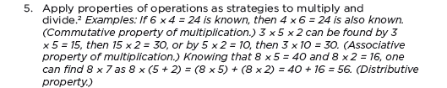

Alignment in Context: Neighboring Grades and Progressions
One of several staircases to algebra designed in the OA domain.
19
Notes:
Algebra begins in 6.EE.3 in its cleanest sense. Here is a beautiful illustration of the design of the standards.
{read slide}

Slide 20
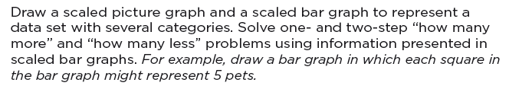
Coherence: Link to Major Topics Within Grades
Example: Data Representation
Standard 3.MD.3
Notes:
Instead of bar charts being “yet another thing to cover,” detracting from focus, the standard is telling you how to “aim” bar charts back around to the major work of the grade. These connections are explicit in the standards. While in the past picture or bar graphs might have been distinct things to be assessed, now they need to be connected to the major work of the grade.

Slide 21
Coherence: Link to Major Topics Within Grades
Example: Geometric Measurement
3.MD.7
Notes:
Another example of coherence within a grade: Volume is not just another topic to cover in Grade 5 . It is explicitly linked to addition and multiplication in the standards.

Slide 22
Shift #3 Fluency
Fluency is not meant to come at the expense of understanding but is an outcome of a progression of learning and sufficient thoughtful practice. It is important to provide the conceptual building blocks that develop understanding in tandem with skills along the way to fluency.
Fluency is developed through making sense of mathematical ideas over time and developing thinking strategies until they can become easily useful and applicable.
Notes:
Creating building blocks
Not meant to come at the expense of understanding
Instead is the outcome of a progression of learning and sufficient thoughtful practice
The standards have explicit places where it requires fluency…but Note that this is not memorization absent understanding. This is the outcome of a carefully laid out learning progression.
At the same time, we can’t expect fluency to be a natural outcome without addressing it specifically in the classroom and in our materials. Some students might require more practice than others, and that should be attended to.
Additionally, there is not one approach to get to speed and accuracy that will work for all students. All students, however, will need to develop a way to get there.
It is important to note here that while teachers in grades K-5 may find creative ways to use calculators in the classroom, students are not meeting the standards when they use them--not just in the area of fluency, but in all other areas of the standards as well.

Slide 23
Required Fluencies in K-6
Grade | Standard | Required Fluency
K | K.OA.5 | Add/subtract within 5
1 | 1.OA.6 | Add/subtract within 10
2 | 2.OA.2 2.NBT.5 | Add/subtract within 20 (know single-digit sums from memory) Add/subtract within 100
3 | 3.OA.7 3.NBT.2 | Multiply/divide within 100 (know single-digit products from memory) Add/subtract within 1000
4 | 4.NBT.4 | Add/subtract within 1,000,000
5 | 5.NBT.5 | Multi-digit multiplication
6 | 6.NS.2 6.NS.3 | Multi-digit division Multi-digit decimal operations
Notes:
This chart shows a breakdown of the required fluencies in grades K-6.
Fluent in the particular Standards cited here means “fast and accurate.” It might also help to think of fluency as meaning the same thing as when we say that somebody is fluent in a foreign language: when you’re fluent, you flow. Fluent isn’t halting, stumbling, or reversing oneself.
The word fluency was used judiciously in the Standards to mark the endpoints of progressions of learning that begin with solid underpinnings and then pass upward through stages of growing maturity.
Some of these fluency expectations are meant to be mental and others with pencil and paper. But for each of them, there should be no hesitation about how to proceed in getting the answer with accuracy.

Slide 24
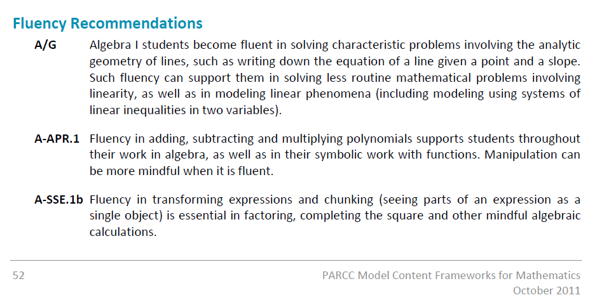
Fluency in High School
Notes:
There are some key aspects of high school math that also require speed and accuracy. There are no specific fluency requirements in the HS content standards, but these are suggestions for fluency based on what is being asked of the students at this level. {Note that more of these recommendations can be found in the PARCC Model Content Frameworks.}

Slide 25
Shift #4 Deep Understanding
A Solid Conceptual Understanding
Teach more than “how to get the answer” and instead support students’ ability to access concepts from a number of perspectives
Students are able to see math as more than a set of mnemonics or discrete procedures
Conceptual understanding supports the other aspects of rigor (fluency and application)
Notes:
Support the students’ ability to access concepts from a number of perspectives
More than “how to get the answer”
Deep conceptual understanding of core math concepts by applying them to new situations
Writing and speaking about their understanding
Conceptual understanding: Teachers teach more than “how to get the answer” and support students’ ability to access concepts from a number of perspectives so that students are able to see math as more than a set of mnemonics or discrete procedures. Students demonstrate deep conceptual understanding of core math concepts by solving short conceptual problems, applying math in new situations, and communicating their understanding

Slide 26
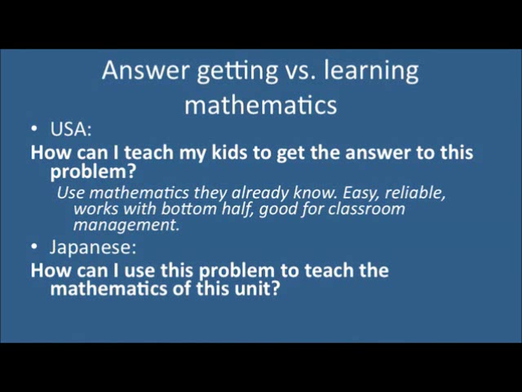
Notes:
Phil Daro (a lead writer of the CCSSM) discussing conceptual understanding versus “answer getting”.
This video can be seen in its entirety at http://vimeo.com/30924981

Slide 27
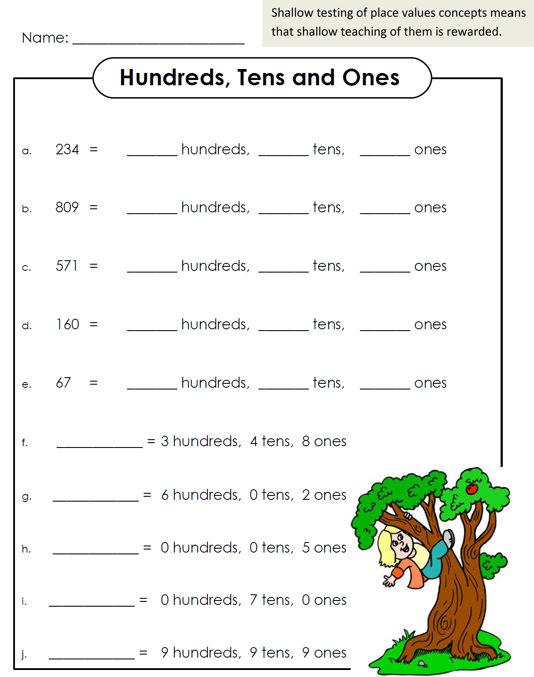
This example does NOT elicit conceptual understanding.
Notes:
Here is an example of a place value chart that you get when you search for “place value worksheets” online. It is also a non-example of work that would elicit conceptual understanding. As you can see, it would not be possible to assess whether your students had a conceptual understanding of place value by them completing this worksheet. It would be fairly obvious to a student who does not understand place value that the first number goes with hundreds, the 2nd number with tens and so on. Even on #8, where it could have shown deeper understanding, the worksheet places a 0 for tens to eliminate any need for thinking.

Slide 28
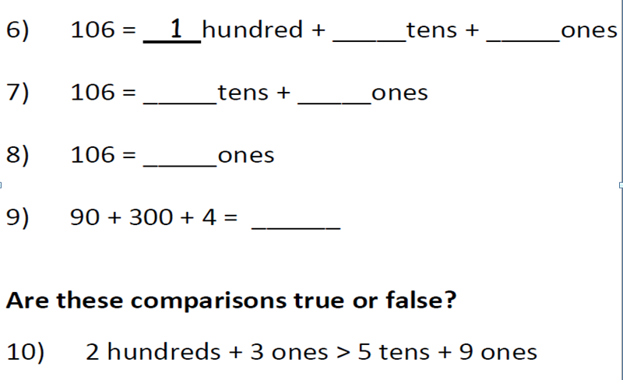
This example provides a better opportunity to assess place value understanding.
Notes:
Here is a snapshot of a worksheet practicing place value understanding. You can see how a teacher would be able to assess a student’s conceptual understanding of place value more clearly with the results of this worksheet. In problems 6-8, the base ten units in 106 are bundled in different ways. This is helpful when learning how to subtract in a problem like 106-37. In #9, we see that if the order is always given “correctly,” then all we do is teach students rote strategies without thinking about the size of the units or how to encode them in positional notation.

Slide 29
Shift # 5 Application
Students can use appropriate concepts and procedures for application even when not prompted to do so.
Teachers provide opportunities at all grade levels for students to apply math concepts in “real world” situations, recognizing this means different things in K-5, 6-8, and HS.
Teachers in content areas outside of math, particularly science, ensure that students are using grade-level-appropriate math to make meaning of and access science content.
Notes:
Using mathematics in problem solving contexts is the third leg of the stool supporting the learning that is going on in the math classroom.
This is the “why we learn math” piece, right? We learn it so we can apply it in situations that require mathematical knowledge. There are requirements for application all the way throughout the grades in the CCSS. {read slide} But again, we can’t just focus solely on application—we need also to give students opportunities to gain deep insight into the mathematical concepts they are using and also develop fluency with the procedures that will be applied in these situations. The problem-solving aspect of application is what’s at stake here—if we attempt this with a lack of conceptual knowledge and procedural fluency, the problem just becomes three times harder.
At the same time, we don’t want to save all the application for the end of the learning progression. Application can be motivational and interesting, and there is a need for students at all levels to connect the mathematics they are learning to the world around them.

Slide 30
Shift #6 Dual Intensity
Students are making sense of mathematics through practicing and understanding.
There is more than a balance between these two things in the classroom – both are occurring with intensity.
Teachers create opportunities for students to participate in application of procedural and conceptual knowledge through extended application of math concepts. The amount of time and energy spent practicing and understanding learning environments is driven by the specific mathematical concept and therefore, varies throughout the given school year.
Notes:
Students are practicing and understanding
Both are occurring with intensity
The amount of time practicing and understanding varies

Slide 31
Implications for Instruction, Curriculum, and Assessment

Slide 32
Implications for Instruction, Curriculum and Assessment
The 6 shifts describe the changes needed in instruction and students’ opportunities to learn math.
The Six Math Shifts and the Mathematical Practice Standards describe what classroom instruction and student learning should look like and sound like.
The PARCC Model Content Framework utilizes shifts

Slide 33
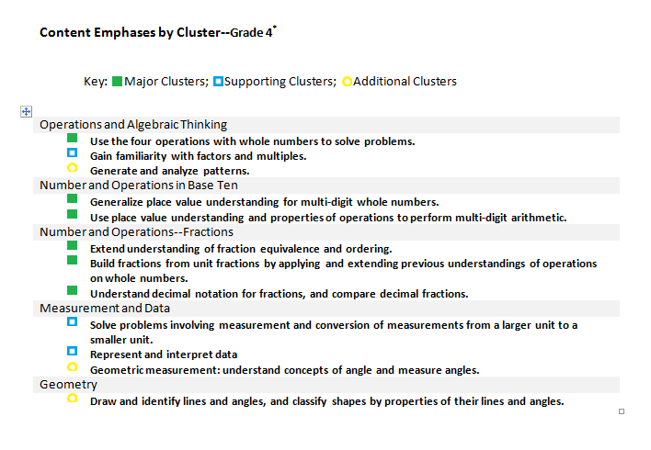
PARCC Model Content Frameworks
Content Emphases by Cluster: Grade Four
Key: Major Clusters; Supporting Clusters; Additional Clusters
Notes:
The PARCC Model Content Framework are build on these shifts. Here is an example of how focus and coherence works in a single grade. This is the emphases by cluster chart for fourth grade. The green boxes represent the major work of the grade, the blue are the clusters that support the major work of the grade and the yellow are the additional clusters.
The emphases charts make visible the intended focus and coherence of the subject matter by identifying the major work (focus) and the supporting and additional work (coherence within and across) The PARCC Model Content Frameworks utilize these shifts in determining the assessment priorities noted as major clusters
For example, here are some connections between supporting and major.
Gain familiarity with factors and multiples: Work in this cluster supports students work with multi-digit arithmetic as well as their work with fraction equivalence.
Represent and interpret data: The standard in this cluster requires students to use a line plot to display measurements in fractions of a unit and to solve problems involving addition and subtraction of fractions, connecting it directly to the Number and Operations--Fractions clusters.

Slide 34
Implications for Curriculum, Instruction and Assessment
Content Emphases by Cluster
Not all of the content in a given grade is emphasized equally in the standards. Some clusters require greater emphasis than the others based on the depth of the ideas, the time that they take to master, and/or their importance to future mathematics or the demands of college and career readiness. In addition, an intense focus on the most critical material at each grade allows depth in learning, which is carried out through the Standards for Mathematical Practice.
To say that some things have greater emphasis is not to say that anything in the standards can safely be neglected in instruction. Neglecting material will leave gaps in student skill and understanding and may leave students unprepared for the challenges of a later grade.
Notes:
7

Slide 35
Implications for Curriculum, Instruction and Assessment
Rigor of daily math tasks (must include high cognitive demand engaging tasks)
Standards for Mathematical Practice- Critical thinking reasoning and communication
Depth of knowledge- Knowledge packets- understanding mathematical concepts deeply applying them within and across standards and content
The classroom should look and sound like the students and teacher are engaging in the Standards for Mathematical Practices
Instructional resources should afford opportunities to make sense of mathematics and develop math ideas over time through the Standards for Mathematical Practices
Students will be assessed on the CCSSM: The Cluster (including headings and numbered statements) and Standards for Math Practice

Slide 36
Implications for Curriculum, Instruction and Assessment
The current U.S. curriculum is often "a mile wide and an inch deep."
Focus is necessary in order to achieve the rigor set forth in the CCSS.
As we saw in the curriculum from other countries, a deep understanding of fewer mathematical concepts pays off.
Instruction must be grounded in CCSSM and the PARCC Model Content Frameworks which includes the Standards for Mathematical Practices
Notes:
Where do we start?
It is very easy to feel overwhelmed by all that is being asked of us in these standards – as stated earlier, this is not just a few shifts in teaching a few topics at different grades then we are use to. The Common Core State Standards in math require big shifts in how math is being taught, practiced, and assessed in the U.S. But where do we start? It starts with Focus.
Remember that we only get opportunities to support coherence and rigor when we first focus.

Slide 37
Implications for Curriculum, Instruction and Assessment
Curriculum resources vetted by PED forthcoming
Publishers criteria for considering curriculum resources:
http://www.corestandards.org/assets/Math_Publishers_Criteria_K8_Summer%202012_FINAL.pdf
Item prototypes
parcconline.org

Slide 38
Resources Used for this Presentation
http://newmexicocommoncore.org/pages/view/86/common-core-state-standards-shifts-in-mathematics/9/
http://newmexicocommoncore.org/mathematics/
http://www.corestandards.org/the-standards/mathematics
www.ped.state.nm.us/
www.achievethecore.org
www.illustrativemathematics.org
http://parcconline.org/parcc-content-frameworks
http://vimeo.com/30924981
Notes:
Acknowledge many slides came from achieve the core

